Slide 1
About C#
Two languages that are central to .NET framework are C# and Visual Basic.
It is fundamentally a simple and object oriented language.
It was developed by Microsoft development team.
Lot of syntax for C# is obtained C language. C# also shares many similarity with popular Java language, thereby making learning of C# even more simpler.
Several version of C# have come up starting from 2002. The latest version in the year 2012 is C# 5.0. Visual Studio 2012 supports this.
For this course, we will stuck with C# 4.0 in Visual Studio 2010.

Slide 2
C# Features
C# is a type-safe, component-based, high-performance language
it is complete object oriented programming Lang
it supports structured error handling
it supports multi threading app development
it support to develop any type of app like console,windows,web etc.
Versions:1.0,1.1,2.0,3.0,3.5,4.0,4.5 and 5.0

Slide 3
A simple C# program
using System;
class HelloClass{
static void Main(){
Console.WriteLine(“Hello World!!!”);
}
}
This program prints “Hello World!” in the console window.
This code can either be written in any text editor like notepad or can be written by creating a new Project in Visual C#.
Writing in notepad will require compilation from the command prompt while in Visual C# we can use the compilation buttons in the Studio.

Slide 4
Understanding the code
using System;
class HelloClass{
static void Main(){
Console.WriteLine(“Hello World!”);
}
}
Namespace library that has to be included for printing and reading from console
C# requires you put all the code inside a construct called class.
Execution starts from here
Writes Hello World! on the console

Slide 5
Comments
Single line comment
//
// This is a single line comment
Multiline comments
/* */
/* This is a multi
line comment */

Slide 6
Variables
Variables are storage locations that are associated with a value.
The value that a variable stores are of certain data type.
Syntax: Datatype var_name;
There are different types of variables that can be defined in C# depending on the scope : static variables, instance variables, array elements, and local variables.
The variables created inside Main() are local. They are available only inside the method where they are declared.
The local variable must always be initialized before using.

Slide 7
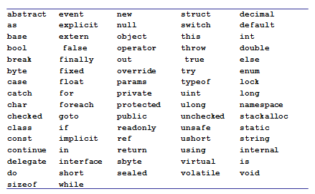
Keywords

Slide 8
C# Data types
C# like C and C++ is a strongly typed language and so every variable must have a data type.
Data types in C# are of 2 types
Value types
Reference types.

Slide 9
C# Data types
Value types
Built in Data types like int, char, float ,double and user defined types like struct or enum
For every value type there is a type(Class or Struct) in BCL
They are allocated in stack
Value types can not contain the value null.

Slide 10
C# Data types
Reference
User defined type created using class or interfaces
Reference types are allocated in heap at runtime.
Reference types can contain the value null

Slide 11
C# Value Types
Built in Types
Boolean type
bool
Integer types
byte int long sbyte short uint ulong ushort
Character type
char
Floating point types
decimal double float
User Defined Types
enum
struct

Slide 12
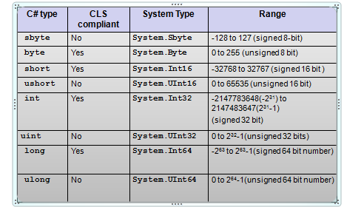
Integer types

Slide 13
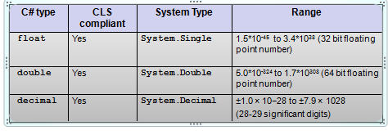
Floating point types

Slide 14
Floating-point literals
Floating-point literals can be written in two ways
Fixed notation: 3.14
Scientific notation: 0.314E1, 314e-2
Floating-point literal types
Literal with no suffix→ is double
Literal with F or f as suffix (Example 3.14f, 3.14F)→ is float
Literal with D or d as suffix (Example 3.14D, 3.14D) → is double
Literal with M or m as suffix (Example 3.14m, 3.14M) → is decimal
decimal d = 3.45; //error
decimal d = 3.45m; //ok
float f = 3.4;// error
float f = 3.4f;// ok

Slide 15
Character type and Character Literal
char keyword is alias for System.Char
It is CLS compliant.
char c=‘a’; //ok
char c=1; //error

Slide 16
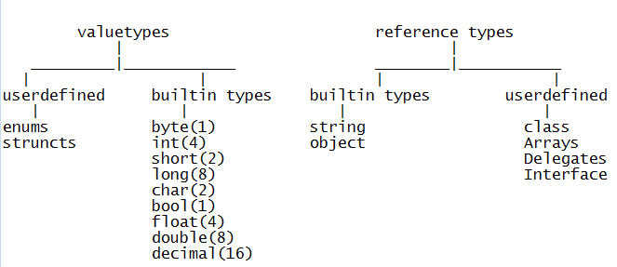

Slide 17
Reading inputs from the console
Console.ReadLine() Reads the next line of characters from the standard input stream.
Console.Read() reads a character and returns in the form of int.
using System;
class SayHello{
public static void Main(){
string s;
Console.Write("Please your name”);
s = Console.ReadLine();
Console.WriteLine(“Hello “+ s);
}}

Slide 18
Identifiers Naming Rules
Identifiers are variables, methods , class or any other named constructs in C#
Rules
Should not be a keyword
Must start with a letter or underscore or @
Subsequent characters can be a letter, number or underscore

Slide 19

Console output Formatting
Write statement can be used to print any type of variable.
Console output can be formatted using Write statement.
Example:
int intval=90;
double doubleval=9.99;
bool boolval=true;
Console.WriteLine("Double value= {1} \n
Int value= {0} \n Boolean value= {2} ",
intval, doubleval, boolval);
Specifies the argument index

Slide 20
Operators

Slide 21
Operators-Arithmetic
+ | - | / | * | ++ | -- | %
Most of the operators work the same way as it does in C.
Applicable to integer and floating point types
int i = 10;
int j = i+ 255;
byte k = i + 255; //error
const double PI = 3.14;
double f = PI + 12;
When 2 of any integral types (other than long) are involved in arithmetic operation, the result is an int.
byte i = 10;
byte j = 20;
j=j+i; //error

Slide 22
Operators-Relational
== | != | < | > | >= | <=
Relational operator return bool value – true or false.
int i=10;
int j=20;
Console.WriteLine( i>j ); // output is False
Console.WriteLine(i == 10); // output is True

Slide 23
Operators-Logical
&& | || | !
These are both boolean operators. These work only on bool values.
&& checks if the first condition is false. If it is so then it doesn't evaluate the second condition.
|| checks if the first condition is true. If it is so then it doesn't evaluate the second condition.
int i=0;
int j=2;
bool b= (i>j) && (j++>i);
Console.WriteLine(j);
What does the code print?

Slide 24
Assignment Operators
= | += | -= | *= | /= | %=
int a = 10;
int b=2;
a+=b; // 12 same as a=a+b;
Console.WriteLine(a);
double d=45.3;
d/=1.2;
Console.WriteLine(d); // 37.75 same as d=d/1.2
float d1=2.4f;
d1 %= 1.2f;
Console.WriteLine(d1); // 0

Slide 25
Other Operators
Operator | Name | Example
?: | Ternary operator | 10 % 2 > 0 ? 1 : 10
[] | Array subscript | a[1]
() | Cast
. | dot operator | n.Length
is | Type Conversion
as
typeof | In refection
new
checked
unchecked
=> | Lambda

Slide 26
Conversion

Slide 27
Conversions
Type conversion is a process of converting values from one data type to another data types
Conversion types:
Implicit Conversion
Casting
Boxing
Un Boxing

Slide 28
Implicit Conversions
Implicit numerical conversions
byte → short, int, long, float, double, decimal
char →int, long, float, double, decimal
short →int, long, float, double, decimal
int →long, float, double, decimal
long →float, double, decimal
float → double

Slide 29

Example
using System;
class Convert{
public static void Main(){
char c='A';
int i=c;
Console.WriteLine(i);
long l=23456789100;
float f=l;
Console.WriteLine(f);
}}
vice versa is not allowed implicitly

Slide 30
Casting
Any conversion that happens in the opposite direction of implicit numerical conversions requires explicit request from the compiler through casting.
Casting
Number casting example
long l2 = 12500;
int i2 = (int)l2;
int i = 256;
byte b1 = (byte)i;

Slide 31
Casting
floating point cast to int example
float f=12.f;
int i2 = (int)f;
Example 1:
float b1 = 1f; int b2 = 2;
float b3 = b1 + b2;
Example 2:
long b1 = 1; double b2 = 2;
double b3 = b1 + b2;
Example 3:
double b2 = 2;
int a3 = (int)b2;

Slide 32
Convert
Note that conversions of numeric value to string and vice versa, bool to string and vice versa etc. is not possible either implicitly or explicitly.
This can be done through the methods below:
Example:
/* Boolean values */
ii= Convert.ToBoolean("true");
Console.WriteLine(ii); //True
ii = Convert.ToBoolean("gg");
Console.WriteLine(ii); // Runtime error call //FormatException

Slide 33
Convert
/* String values */
string s= Convert.ToString(true);
Console.WriteLine(s); //True
s = Convert.ToString(1.23);
Console.WriteLine(s); //1.23
s = Convert.ToString('A');
Console.WriteLine(s); //A
Console.WriteLine(Convert.ToString(null));
// prints nothing
/* Numeric Values */
int i = Convert.ToInt32("1009");
short j = Convert.ToInt16("100");
long k = Convert.ToInt64("9292929");
byte b=Convert.ToByte("20");
No ToFloat method!
double d=Convert.ToDouble("sss"); // runtime error

Slide 34
Parse() Method
Another way to convert strings to basic type is by using System Type
Every System Type has Parse() method that can be used to convert a string into the respective System Type.
<Type>. Parse(string s)
Where <Type> could be any System Type/ C# type that we looked at earlier.
using System;
class ParseTest{
static void Main(string[] args) {
sbyte i1= sbyte.Parse("123");
float f1= float.Parse("123.3");
decimal d1= decimal.Parse("123.45");
bool b= bool.Parse("true");
Console.WriteLine("{0}, {1}, {2}, {3}, {4}, {5}, {6}", i1, f1, d1, b);
}}

Slide 35
Boxing And Unboxing
Boxing and unboxing allows a value-type to be converted to and from type object.
Converting a value type to reference type is called Boxing. Boxing is implicit conversion.
int i = 1;
object o = (object)i; // boxing
Or simply object o=i;
And reverse is unboxing
o = 1;
i = (int)o; // unboxing
Unboxing is explicit conversion.
When value-type are boxed they are stored in heap.
Boxing and unboxing are computationally expensive processes.

Slide 36
Conditional Statement & Loops

Slide 37
Decision constructs: if statement
if statement
if(Condition)
{
statements;
}
Condition must evaluate to bool value

Slide 38
Decision constructs: if-else statement
if/else statement
if(Condition)
{ statements; }
[
else{
statements;
}
]
Example: if (c > 0) c++; else c--;
Condition must evaluate to bool value

Slide 39
Decision constructs: switch statement
switch statement
switch(var)
{
case val1:
statements;
break;
case val2:
statements;
break;
……
default: statements;
break; }
Any numeric value or string
constants

Slide 40
Example
char c;
c = char.Parse(Console.ReadLine());
switch(c){
case 'r': Console.WriteLine("RED");
break;
case 'g': Console.WriteLine("GREEN");
break;
case 'b': Console.WriteLine("BLUE");
break;}
}
C# compiler enforces that every case statement must have a break statement. In other words control cannot fall through from one case label to another.

Slide 41
Multiple Cases
char c;
c = char.Parse(Console.ReadLine());
switch(c){
case 'r':
case 'R':Console.WriteLine("RED");
break;
case 'g':
case 'G': Console.WriteLine("GREEN");
break;
case 'b':
case 'B': Console.WriteLine("BLUE");
break;}
}

Slide 42
Looping Statements- for statement
There are two forms of for statement
for loop
for(intialization; condition;increment/decrement){
//statements
}
Ex: for(int i=0;i<10;i++)
foreach loop:
foreach(object variable in itemlist){
//statements
}
Ex: int[] arr={1,2,3,4,5};
foreach(int s in arr)
Console.WriteLine(s);

Slide 43
while and do while
// while loop
while(Condition) {
statements
}
Ex: int i=0;
while(i<10) {
Console.WriteLine(i);
i++; }
do-while loop
do{
statements
}while(Condition);
Ex: int i=0;
do {
Console.WriteLine(i);
i++;
} while(i<10);
Condition must evaluate to bool value

Slide 44
break and continue
Used with loop statements
break is used to break out of the loop. Is used with switch statement also.
continue is used to exit out of current iteration and continue with the next iteration.
int j = 100;
while (true)
{
if (j % 13 == 0) break;
else
j++;
}
Console.WriteLine(j); //104

